Slide 1
The American Model
Lecture 12, Chapter 18 book
Vinish Shrestha

Slide 2
Econ 339 - Roadmap
Focus Midterm 1
Focus Midterm 2
Focus Final
Review of Microeconomics
Socioeconomic
Disparities
Chapter 4
Moral hazard
Chapter 11
Intro (from my slides)
Demand for Insurance
Chapter 7
Uncertainty
Risk aversion
The health policy conundrum
Chapter 15
Production of Health
The Beveridge Model
Chapter 16
Adverse selection
Chapters 8 and 9
Akerlof’s market for lemons
Rothschild-Stiglitz model
Demand for health care
Chapter 2
The American Model
Chapter 18 and slides provided (ACA)
The Grossman model
Chapter 3
Adverse Selection in
Real market
Chapter 10
Special Topics (if time allows)
Chapter 20
Slides provided
11/26/17
Towson University – V. Shrestha

Slide 3
Class plan
Brief History of the US health care
Employer Sponsored health insurance
Job lock
The managed care
Medicare and Medicaid
Massachusetts Health Care Reform
Patient Protection and the Affordable Care Act

Slide 4
The U.S. Health Care
In 1943, during the depths of World War II
High inflation times
Freeze wages at the existing levels and employer could raise them even for the most productive ones
Employers started giving out health insurance as a non-wage perk
Not technically considered wages

Slide 5
After war and Truman’s Universal Health Insurance
Wage freeze lifted after the war
Harry Truman pushed universal health insurance (Fair Deal agenda in 1949)
Plan defeated
Lobbying effort from American Medical Association (AMA)
Obtaining health insurance for elderly difficult

Slide 6
Public Insurance
In 1960s, Lyndon adopted the plan to cover the elderly
Medicare and Medicaid enacted in 1964
US insurance system
Employer sponsored
Individual health insurance
Medicare and Medicaid
Uninsured (50 million before ACA)
ACA

Slide 7
Employer Sponsored Health Insurance
https://www.kff.org/other/state-indicator/total-population/?currentTimeframe=0&sortModel=%7B%22colId%22:%22Location%22,%22sort%22:%22asc%22%7D
https://www.kff.org/interactive/premiums-and-worker-contributions/#/?filter1=

Slide 8
Employer Sponsored Health Insurance
Around 50 percent of Americans receive ESI
Two parts
Employer’s Contribution
Worker’s Contribution
Wage pass-through: Phenomenon of insurance cost coming from worker’s wage.
Tax break
Worker’s contribution is not taxed

Slide 9
Employer Sponsored Health Insurance
Individual market and adverse selection
Prone to adverse selection
ESI
Combats adverse selection (pooling)

Slide 10
Consider BHT Enterprise
Has four employees
Two young, two old
One young has migraine, one old is quite healthy
Existence of Asymmetric Information regarding actual health
Has information about age
Older pay high
Younger low
Separates the pool (prevent adverse selection)

Slide 11
Wage pass-through
Suppose BHT pays $4,000 in premium (monthly) for all four employees
Evenly distributed ($1,000 each)
Healthy workers leave and find fair deals
BHT has to use wage pass-through to “charge” older employees more for health insurance
Through forgone wages
Two older pay $1,500 and two young pays $500

Slide 12
Evidence of wage pass-through
Note: employer’s premium contribution being passed through as employee’s wages
In 1976 the federal law mandated maternity care for employer-sponsored insurance plan
Premiums increases for employers with high number of females in reproductive years
Wages rise more slowly (Gruber, 1994)

Slide 13
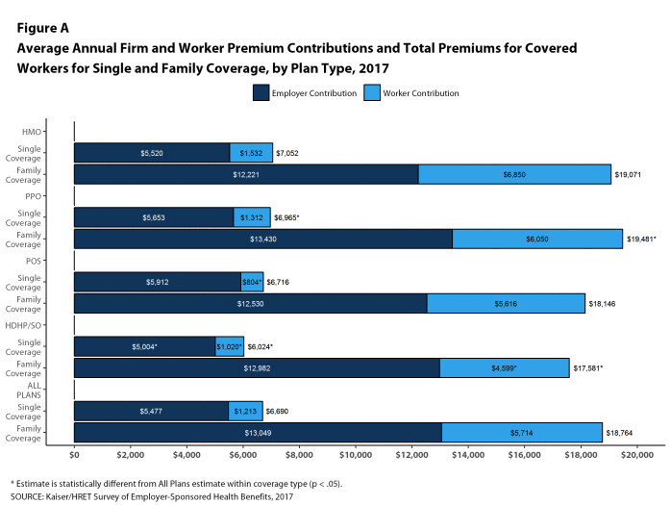

Slide 14
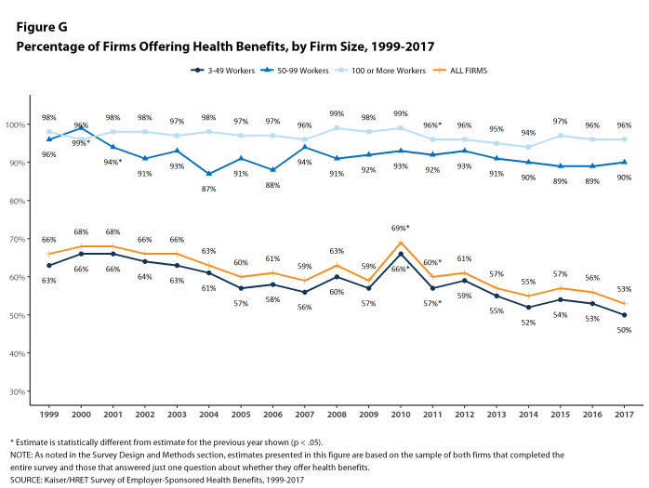

Slide 15
Massachusetts Health Care Reform

Slide 16
MA Health Care Reform
In 2006, the state of Massachusetts passed the legislation
Almost universal health care insurance coverage
The Commonwealth Health Insurance Connector http://www.mass.gov/eohhs/insurance/
Subsidized and non-subsidized private health insurance
Subsidy for income below 300% of FPL
Up to 150% of FPL, full subsidy

Slide 17
MA Health Care Reform
2. Insurance market reform
Insurers are to issue plans regardless of health status and community ratings
Minimum credible coverage and maximum payment
Community rating: prevents insurers to vary premiums within a geographic
area based on age, gender, health status or other factors

Slide 18
MA Health Care Reform
3. MassHealth Expansion
Both Medicaid and Children Health Insurance Program (CHIP) expanded up to 300% FPL ($32,670 for individual and $67,050 for family of four)
4. Employer Requirement
More than 11 employee should contribute
5. Individual Mandate
,
,

Slide 20
Average coverage rate by year
Source: Kolstad and Kowalski (2012)

Slide 21
What can we learn from MA?
Increase in coverage
Over 40 percent reduction in uninsured population since 2006 to 2010
Rise in access to care
Rather than crowd out of private insurance by public insurance, has been crowd in of ESI
Mandate implementation has been “smooth”
Cost of the reform has been close to its projection ($750 mil. Versus $800 mil.)

Slide 22
Kolstad and Kowalski (2012)
Decreased uninsurance rate by 36 percent
Among hospital discharges
Decrease length of hospital stay and inpatient admission from the emergency room
Did not increase hospital cost
Provides an opportunity to study wage pass-through.
What share of full cost of health insurance is pass through to employees as lower wages?

Slide 23
Labor Market Effects of MA Health Insurance Reform
2004 panel of Survey of Income and Program Participation
Followed participants from 2003 to 2007
Full-time workers who gained coverage as a result of the reform earned $6,055 less per year compared to if they had not received ESI
Close to entire cost of health insurance to their employers

Slide 24
Source: Kolstad and Kowalski 2012

Slide 25
The Patient Protection and Affordable Care Act (ACA) Obama Care

Slide 26
A 3 Legged Stool
What would happen if everyone is guaranteed insurance access at prices that are independent of their health status?
Limits on age bands (3:1), outlawing pre-existing conditions & possibility of free riding (adverse selection)
2. Requirement that individuals purchase insurance (individual mandate)
3. How can someone purchase a health insurance if its not affordable?
Expansion of Medicaid, and tax credits

Slide 27
ACA and the Goal

Slide 28
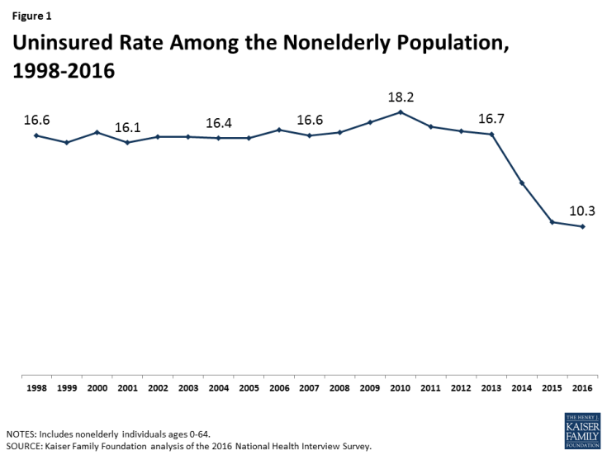

Slide 29
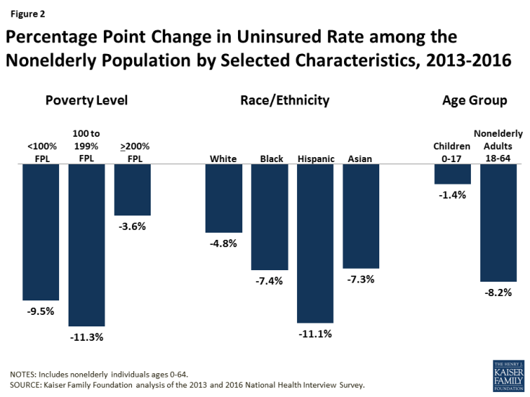

Slide 30
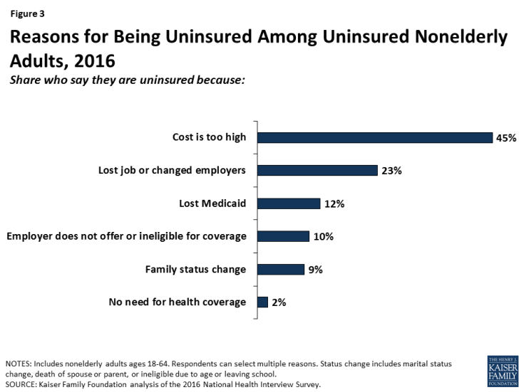

Slide 31
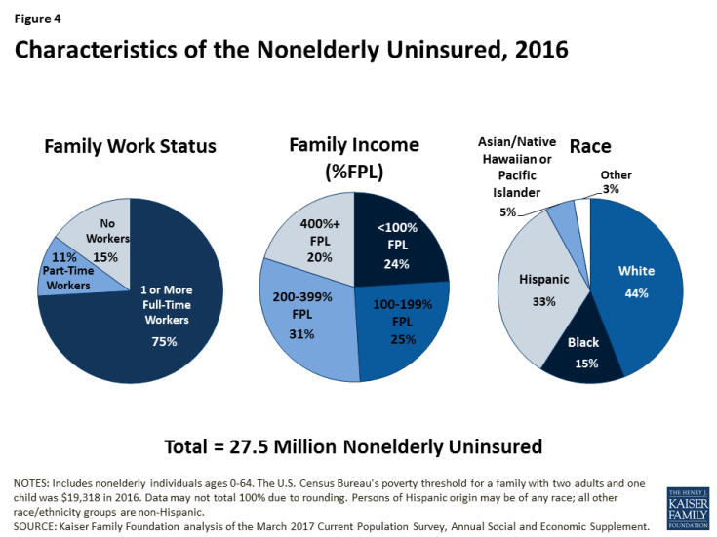

Slide 32
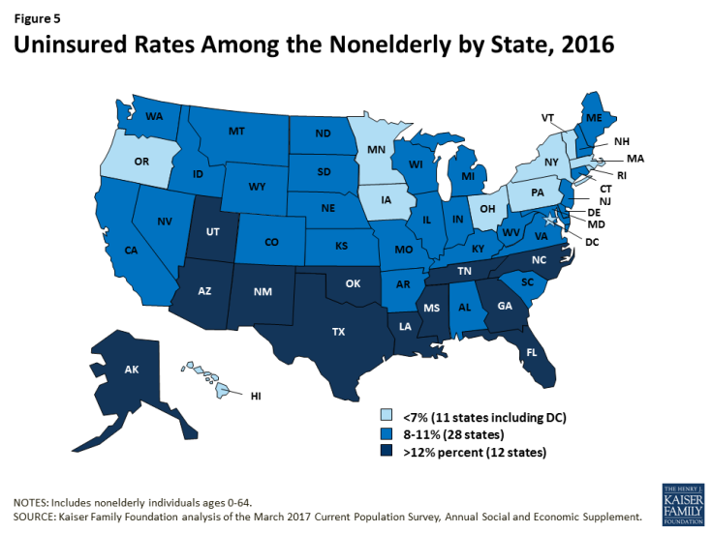

Slide 33
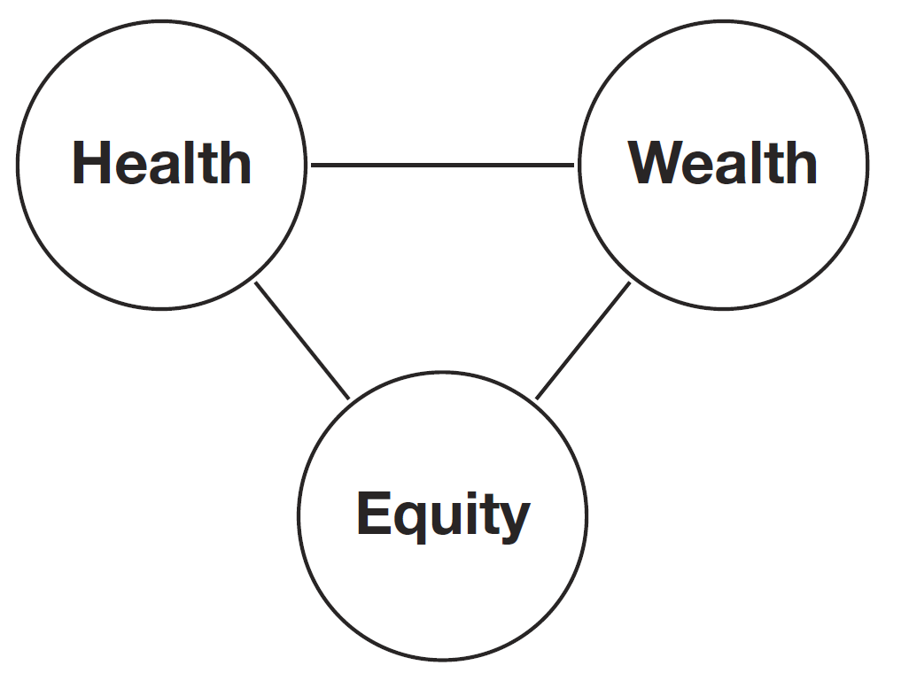
ACA targets equity.

Slide 34
Goals for Reform
Expand health insurance coverage
48 million uninsured in 2012 (15.4% of population or 18% of under 65 population)
Improve coverage for those with health insurance
Improve access to and quality of care
Control rising health care costs
CBO projects $940 billion in new spending, and $1,080 billion in spending reduction and revenue increases.

Slide 35
Problems when Expanding Insurance Coverage
Adverse selection
Adding relatively risky people into the pool
Increase in risk increases premium
Leads relatively health to drop out
Mandatory health insurance coverage, expansion of dependent coverage mandate
Moral Hazard
Demand for health versus inflated demand
Just because you have health insurance coverage
Asymmetric information

Slide 36
Expanding Coverage
Individual mandate
Employer mandate
Expansion of Medicaid
Changing rules of insurance

Slide 37
Individual mandate
U.S. citizens and legal residents to have qualifying health insurance (mandate upheld by the supreme court).
Can be covered through:
A government program (Medicare, Medicaid, VA)
Employer
Self-purchased
How to make it affordable?

Slide 38
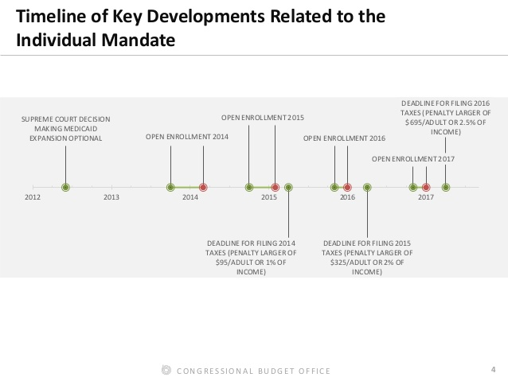

Slide 39
Assistance for Individual Mandate
Provides premium subsidies to eligible individuals and families with incomes up to 400% of the poverty level ($45,960/individual or $94,200/family of 4) through the Exchanges.
Example: Premium contribution for family of 4 at 400% of Federal Poverty Level will be limited to 9.5% of income ($8,949)
Note that average premium is $6,251 (single) and $17,545 (family) in 2015
Example: Premium contribution for family of 4 at 133% of Federal Poverty Level will be limited to 2% of income ($626)
Provides cost sharing subsidies to the same groups.
To reduce out of pocket expenditures.
Create new Health Insurance Exchanges where individuals and small employers can purchase coverage

Slide 40
Insurance Exchanges
Designed by states, groups of states, or the Federal Government if states do not create one.
Usually state-wise, online marketplace when you can buy insurance
https://quote.affordable-health-insurance-plans.org/Exit/PreQuote?leadType=HEALTH&trafficType=ZipSubmit&as=0sha5nhavbhhnnt12addfmko
Individuals and small businesses (100 employees) can purchase insurance through the exchange.
At least two multi-state plans must be offered. (Age rating band)
At least one plan must be offered by a non-profit entity (ACA also provides incentives to foster the creation of these plans.)
At least one plan must not provide abortion coverage beyond those permitted by federal law.
Insurance companies can still sell plans outside of the exchange, but subject to most of the same rules.
If a state has fewer standards or less scrutiny over practices, prices may be lower.
Subsidies only available in the exchange.

Slide 41
Insurance Exchanges
Benefits offered in four categories, all provide essential health benefits but have different levels of cost sharing. All subject to out-of-pocket maximums.
Bronze (covers 60% of the benefit costs of the plan)
60% of cost sharing on average
Actuarial value (better AV means better cost sharing)
Silver (covers 70% of the benefit costs of the plan)
Gold (covers 80% of the benefit costs of the plan)
Platinum (covers 90% of the benefit costs of the plan)
Catastrophic plan offered for those exempt from the mandate. Only available in individual market.

Slide 42
Insurance Benefits
Plans must offer the same set of essential health benefits. Plans may offer more benefits.
Ambulatory patient services (outpatient care you get without being admitted to a hospital)
Emergency services
Hospitalization (such as surgery)
Maternity and newborn care
Mental health and substance use disorder services, including behavioral health treatment (this includes counseling and psychotherapy)
Prescription drugs
Rehabilitative and habilitative services and devices (services and devices to help people with injuries, disabilities, or chronic conditions gain or recover mental and physical skills)
Laboratory services
Preventive and wellness services and chronic disease management
Pediatric services

Slide 43
Penalty for Not Insuring
Individuals:
2014: Greater of $95 or 1% of taxable income
2015: Greater of $325 or 2% of taxable income
2016: Greater of $695 or 2.5% of taxable income
Beyond: ($695+ adjustment for inflation) or 2.5% of taxable income
Exemptions: Financial hardship, religious objections, very low income,…

Slide 45
Percentage of Tax Returns with Reported Individual Mandate Penalties
Source: Mach, 2017 (CBO)

Slide 46
Who are the people affected by the penalty?

Slide 47
https://www.washingtonpost.com/news/powerpost/paloma/the-health-202/2017/11/20/the-health-202-republicans-are-right-the-individual-mandate-is-a-tax-on-the-poor/5a0f2dc030fb045a2e003215/?utm_term=.995483ebfc6f https://www.washingtonpost.com/news/wonk/wp/2017/11/14/why-repealing-obamacares-individual-mandate-is-so-crucial-for-tax-reform/?utm_term=.f02b165e5714

Slide 48
What can happen if the individual mandate is repealed?
Pros
Cons

Slide 49
Employer mandate
Employers with 50+ full time employees must offer insurance to employees (effective Jan 1, 2015). Employees do not have to accept coverage. “Employer Mandate”
But, employees who turn down the coverage are not eligible for the premium subsidies unless the employer sponsored plan is too expensive (as defined by the law).
No requirement or penalties for employers with less than 50 full time employees.

Slide 50
Assistance for Employers
Small employers who do buy health insurance for employees get a tax credit of up to 35% of the employer’s contribution to the premium.
Small is defined as 25 or less employees and average annual wages <$50,000
In 2015, average employer contribution was
$12,591 out of $17,545 (family plan)

Slide 51
Penalties for Employers
Penalty for non-offering:
if any employee receives the premium subsidy then the employer owes $2000 per full time employee, excluding the first 30 employees from the assessment.
Penalty for non-take up by employees (offer but too expensive):
if any employee receives the premium subsidy then the employer owes the lesser of $3000 per employee getting a premium subsidy, or $2000 per full time employee, excluding the first 30 employees.
Tax on high value health plans:
If the value exceeds $10,200 for individual or $27,500 for families then a 40% tax is imposed on the premium above these thresholds. (Ex: If a plan is valued at 11,200 the employer pays $400. ((11,200-10,200)* .40)

Slide 52
Source: Kolstad and Kowalski, 2016

Slide 53
What are the effects of employer sponsored mandate through ACA on labor market outcomes including wages?

Slide 54
Expansion of Medicaid

Slide 55
Expansion of Medicaid
Incentives to Expand Medicaid to all individuals under age 65 with incomes up to 133% of the poverty level ($14,856/individual or $60,657/family of 4)
Standard benefit package
Participation by states is voluntary via supreme court case.
Incentives: States receive 100% funding for new enrollees from 2014-2016, 95% in 2017, 94% in 2018, 93% in 2019 and 90% in 2020 and beyond.

Slide 56
Expansion of Medicaid
https://www.kff.org/health-reform/state-indicator/state-activity-around-expanding-medicaid-under-the-affordable-care-act/?currentTimeframe=0&sortModel=%7B%22colId%22:%22Location%22,%22sort%22:%22asc%22%7D

Slide 57
ACA on Health Insurance Coverage
Courtermanche et al. 2016 effects of ACA on insurance coverage across Medicaid expansion and non-expansion states
Full ACA increased insurance coverage by 5.9 percentage points
Only 3 percentage points in states without Medicaid expansion
Private insurance expansions from ACA both due to ESI and non-group coverage
Coverage gain largest
Low income
Non-whites
Young adults
Unmarried individuals

Slide 58
Changing Rules of Insurance
Allow adult children to remain on their parents’ health insurance policy until age 26.
All plans are prohibited from placing lifetime and annual limits on coverage.
All plans are required to have guaranteed issue and renewability. No pre-existing condition exclusions allowed.
Simplify health insurance administration by establishing a standard set of rules of eligibility, enrollment, claims, and payments processes.

Slide 59
Changing Rules of Insurance (Cont.)
Individual and small group market plans offered on a modified community rating basis (age (3:1), location, family size, plan design, tobacco use (1.5:1)).
All plans must spend at least 80% of premiums on clinical services (85% if large group market). If they do not, insurance companies must rebate the difference to the consumers.
Any proposed rate increase by individual or small group market insurers at or above 10 percent will be scrutinized by independent experts to make sure it is justified. Insurance companies must publically provide easy to understand information about their reasons for unreasonable rate increases. States can exclude these companies from the exchanges.
The law requires the use of risk adjustment in the small group and individual markets to reallocate premium income among plans to account for differences in their enrollees’ aggregate health conditions.

Slide 60
How to pay for provisions of ACA
Penalties on individuals and employers.
Increase the Medicare tax rate on wages by 0.9 percentage points (from 1.45% to 2.35%) only for individuals earning $200,000 or couples earning $250,000.
New 3.8% tax on unearned income (interest, dividends, capital gains) for these high income tax payers.
New annual fees on pharmaceutical manufactures and health insurers.
New 2.3% sales tax on medical devices.
New 10% sales tax on indoor tanning services.
Savings from Medicare (reduction in reimbursement to private “Medicare Advantage” programs

Slide 61
Changes to Medicare
Reduce Medicare Disproportionate Share Hospital (DSH) payments.
Reduction in reimbursement to private Medicare Advantage (HMO type plans)
Freezing income related premium thresholds for Part B and reduce subsidy for Part D (drug coverage).
Forms advisory board to recommend ways to reduce the rate of growth of spending
Creates an Innovation Center to test and evaluate different payment structures with the goal of reducing costs and improving quality.
Reduced payments to hospitals for preventable hospital admissions and for some hospital-acquired conditions.
Fills in the doughnut hole.

Slide 62
Supply side incentives
Increase Medicaid payments for primary care services to the level of Medicare primary care. Money comes from Federal Government.
10% bonus to Medicare primary care physicians (2011-2015).
10% bonus to Medicare primary care physicians and general surgeons in health professional shortage areas (2011-2015).
Increasing the number of graduate medical education positions by redistributing currently unused slots. Increase flexibility in laws to ensure availability of residence programs in underserved areas.
More scholarships and loans for health professional training. More training facilities.
More funding for community and school based health centers.

Slide 63
Support for Innovations
Forms a Patient-Centered Outcomes Research Institute to compare clinical effectiveness of medical treatments.
Grants to states to develop and evaluate alternatives to current tort litigations for medical malpractice. Emphasis on reducing medical errors.
Medicare and Medicaid pilot programs for a bundled payment for an illness episode.
Inpatient services, physician services, outpatient services

Slide 64
Wellness Incentives
Develop a national strategy to improve the nation’s health
Private insurance plans are required to provide preventative services at no cost sharing. Includes immunizations and preventive care for children and screenings for women.
No cost sharing for preventive services and some screening tests in Medicare.
Grants for small employers to establish wellness programs.
Employers can offer rewards to employees for participating in wellness programs.
Requires chain restaurants and food sold in vending machines to disclose the nutritional content of each item.

Slide 65
Flow of Dollars and Services,
Before ACA
Insurance companies
Employers
Premiums
Premiums
Payments
Patients/
Consumers
Out of pocket payments
Providers (doctors, hospitals)
Taxes
Medical care services
Medical care services
Payments
Donations
VA medical care
Charity
Taxes
Medicare/Medicaid Payments
Government

Slide 66
Flow of Dollars and Services,
After ACA
Insurance companies
Employers
Premiums
Premiums
Insurance Exchanges
Premiums
Payments
Premiums
Premiums
Patients/
Consumers
Out of pocket payments
Providers (doctors, hospitals)
Taxes
Medical care services
Medical care services
Payments
Donations
VA medical care
Charity
Taxes
Medicare/Medicaid Payments
Government

Slide 67
Questions to consider
Which of these provisions address the problems of adverse selection and are there any that worsen it?
Which of these provisions address the problems of moral hazard and are there any that worsen it?
Will the provisions of the ACA accomplish the goals of the act?
Which of the proposed solutions are market based solutions and which expand government regulation?
Is government regulation necessary to make this market perform more efficiently?

Slide 68
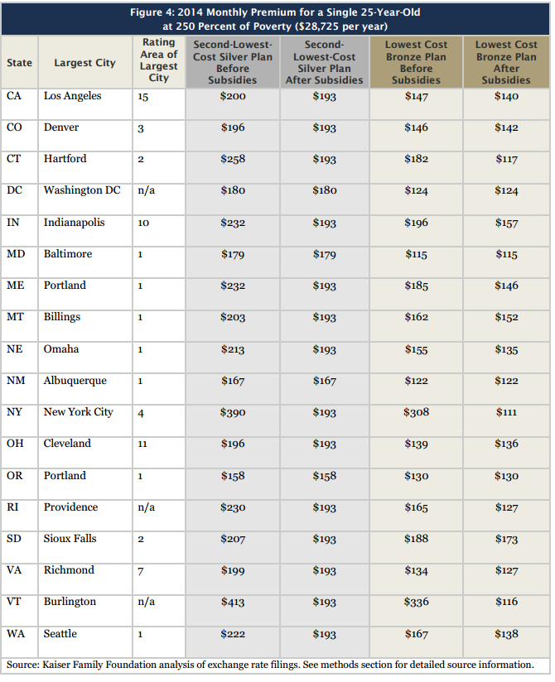

Slide 69
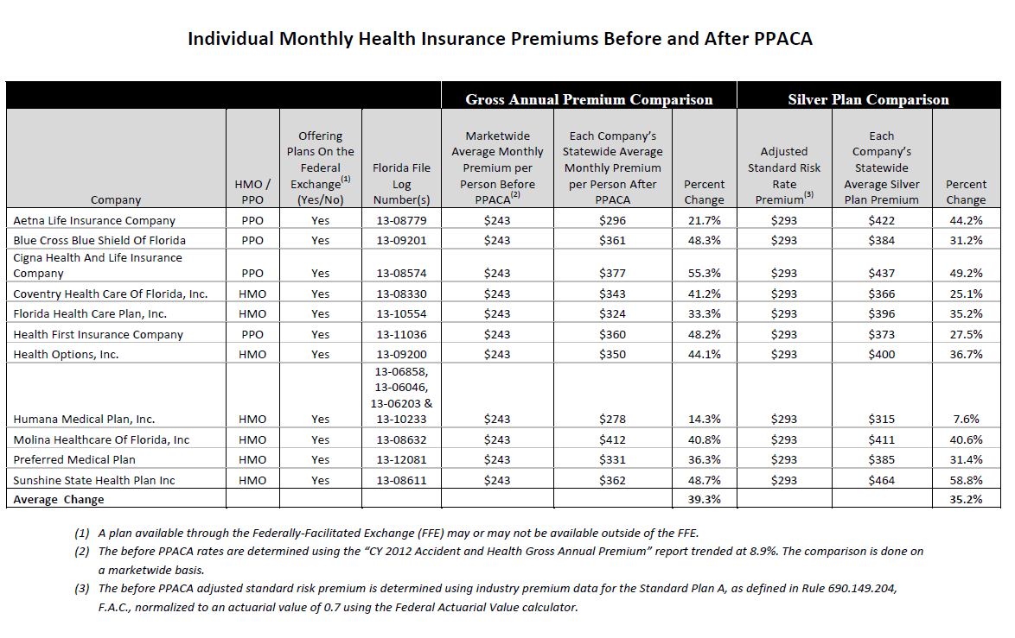
Florida data. Does not include subsidies.

Slide 70
http://www.forbes.com/special-report/2013/what-will-obamacare-cost-you-map.html

